Slide 1


Slide 2
Integrating Palliative Care in Health system of IRAN
دکتر حسین جباری
Ph.D مدیریت خدمات بهداشتی و درمانی
استاد گروه پزشکی اجتماعی دانشکده پزشکی
مسئول دفتر استعدادهای درخشان و المپیاد دانشگاه علوم پزشکی تبریز
jabbariho@tbzmed.ac.ir
drjabbari44@gmail.com

Slide 3
اهداف کارگاه
انتظار می رود که شرکت کنندگان در پایان بحث بتوانند به سوالات زیر پاسخ دهند :
وضعیت مراقبت های تسکینی در نظام سلامت ایران چگونه است(کجا هستیم ؟)
مقصد ارمانی ما کجاست ( به کجا می خواهیم برسیم؟ )
چگونه ( با چه ابزار و رویکردی ؟)

Slide 4
سیمای خدمات بالینی کشور ما در بیمارانی که با شرایط تحدیدکننده حیات (مزمن ،لاعلاج و در مراحل اخر زندگی) مواجه اند
خدمات پرهزینه غالبا با مصرف بیش از حد خدمات
در مراکز و واحدهای غیرادغام یافته
با پاسخگویی و بدون متولی
با مشکلات در دسترسی بهنگام ، ترخیص علی رغم دستور پزشکی بالا
بدون مداومت و پی گیری و .......
طول مدت اقامت ...، میزان عفونتهای بیمارستانی ... ، مصرف انتی بیوتیک ها... و مقاومت های دارویی...
بویژه در بیمارانی که در شرایط تحدیدکننده (مزمن ،لاعلاج و در مراحل اخر زندگی) قرار دارند

Slide 5
If I hear the term ‘Palliative Care’ I think of . . .

Slide 6
Terminologies
1. Palliative care
2. Hospice care
3. Supportive care: Relieving the symptoms in order to improve the quality of life
4. Terminal care
5. End of life care
6.Comfort care: Enhance the quality of life for patients and their families
7. Palliative medicine

Slide 7
What is a health system?
A health system consists of all organizations, people and actions whose primary intent is to promote, restore or maintain health.
This includes eﬀorts to inﬂuence determinants of health as well as more direct health-improving activities.
It includes, for example, a mother caring for a sick child at home; private providers;
behaviour change programms; vector-control campaigns; health insurance organizations;occupational health and safety legislation.
It includes inter-sectoral action by health staﬀ, for example, encouraging the ministry of education to promote female education, a well known determinant of better health.

Slide 8
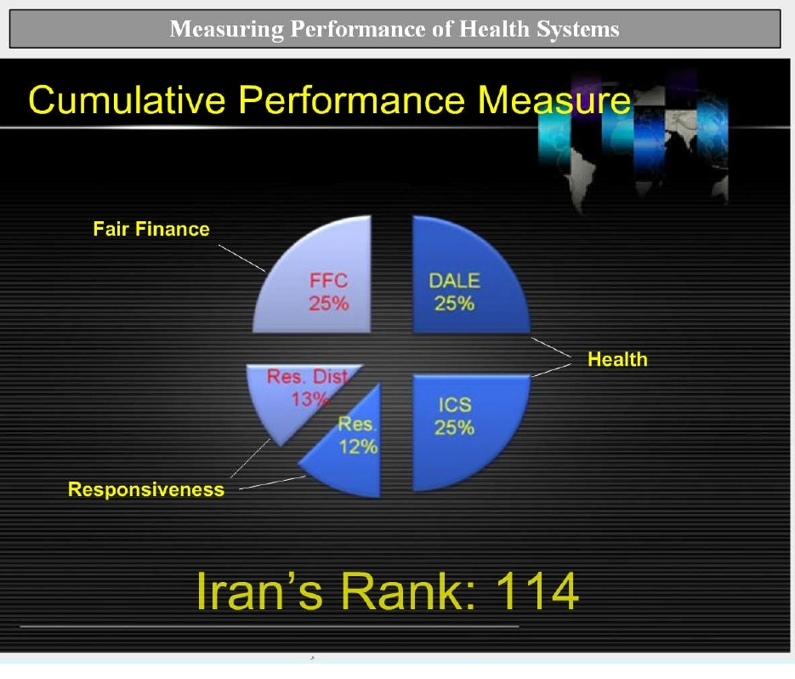
چند شاخص :
Cancer rates/100000:243 in 2020
UHC Service Coverage Index (SDG) :72in 2019
Quality Of Death Index:73rd80 in 2015

Slide 9
چشم انداز اتی
می خواهیم به کجا برسیم ؟
توسعه پایدار یا Sustainable development به معنای تلفیق اهداف اقتصادی، اجتماعی و زیست محیطی برای حداکثرسازی رفاه انسان فعلی بدون آسیب به توانایی نسلهای آتی برای برآوردن نیازهایشان میباشد
پوشش همگانی سلامت

Slide 10
تعریف پوشش همگانی
All people receiving quality health services that meet their needs without being exposed to financial hardship in paying for the services.
طیف خدمات :
ارتقایی ، پیشگیری ، تشخیصی ، درمانی ، بازتوانی و تسکینی

Slide 11
ساختار و بستر حرکت به سوی مقصد
شبکه بهداشت و درمان ، بیمارستان و ...... در ایران
PHC
سطح بندی و ارجاع

Slide 12
PHC :ابزار و رویکرد ؟
Is essential health care based on practical, scientifically , socially acceptable
should be universally accessible; affordable for the community and country
is the central function of health system; first level of contact with health system and brings health care as close as possible to where people live and work,
address the main health problems
should provide health-promotive, preventive, curative, rehabilitative and palliative services across the life-course;
should include:
education on prevailing health problems and on preventing and controlling them; promotion of good nutrition, safe water and basic sanitation; maternal and child health care; immunization

Slide 13
PHC : should include continue
-appropriate treatment for common diseases and injuries, including continuity of care for people with chronic conditions;
-basic palliative care; and provision of essential medicines, including essential controlled medicines such as oral and injectable morphine;
-should be integrated into a referral system and information system resulting in comprehensive, coordinated and continuous health care for all;
-should give priority to those most in need; and should be provided by an appropriately trained team that includes physicians and nurses and also may include clinical officers, assistant doctors, feldshers, nurses, midwives, community workers as applicable, as well as traditional practitioners, as appropriate, to respond to the expressed health needs of the community.

Slide 14
ساختار کلی شبکه ی بهداشت ودرمان
وزارت بهداشت درمان و آموزش پزشکی
دانشگاه علوم پزشکی و خدمات بهداشتی و درمانی
معاون آموزشی
معاون درمان
معاونت بهداشت و رئیس مرکز بهداشت استان
دانشکده ی پزشکی(پیراپزشکی)
بیمارستان تخصصی(آموزشی)
مدیریت شبکه ی شهرستان
مرکز بهداشت شهرستان
بیمارستان عمومی شهرستان
مرکز بهداشتی درمانی روستایی
مرکز بهداشتی درمانی شهری
خانه ی بهداشت
خانه ی بهداشت
خانه ی بهداشت
پایگاه بهداشتی
پایگاه بهداشتی
پایگاه بهداشتی

Slide 15
WHO definition of palliative care:
“An approach that improves the quality of life of patients and their families facing the problems associated with life-threatening illness through the prevention and relief of suffering by means of early identification and impeccable assessment and treatment of pain and other problems-- physical, psychosocial, and spiritual.”

Slide 16
Palliative care focuses on “caring” for the patient and family, not on “curing” the patient, Can be valuable for any age and any stage of a serious, life-limiting illness, Provides symptom relief and support to help patients function as well as possible, Is used in hospitals, other community settings, or homes
Who Provides Palliative Care?
Nurse , Nursing Assistant ,Physician ,Social Worker ,Psychiatrist/Psychologist, Dietitian, Chaplain ,Physical/Occupational Therapist

Slide 17
FACTS
Health professionals need to be trained well in palliative care
Good quality care towards the end of life must be recognized as a basic human right
Simple measures, including pain relief, sensitive communication and well coordinated care, are effective in relieving symptoms and suffering.
Many innovative ways of improving the quality of care towards the end of life are being developed

Slide 18
Definition of Hospice
Hospice care is end-of-life care provided by health professionals and volunteers.
They give medical, psychological and spiritual support. The goal of the care is to help people who are dying have peace, comfort and dignity.
The caregivers try to control pain and other symptoms so a person can remain as alert and comfortable as possible.
Hospice programes also provide services to support a patient’s family.

Slide 19
سئوال شماره 1:
1-میزان نیاز به مراقبت های تسکینی در نظام سلامت ایران را چقدر براورد می نمائید:

Slide 20
سئوال شماره 2:
چه بخشی از این بیماران در بیمارستانها بستری می شوند و برای چه مدت ؟

Slide 21
سئوال شماره 3:
3- بعد ترخیص از بیمارستان ( در مراحل انتهایی عمر ) چگونه مراقبت می شوند؟

Slide 22
اقامت بیشتر ،عفونت ،مصرف انتی بیوتیک ،مقاومت دارویی و ...
Conclusions: A vicious circle in palliative care involves the following order:
length of stay increased rate of infection use of antibiotics
MDROs use of broad spectrum antibiotics
increased length of stay
Therefore, using antibiotics for aggressive treatment of infections in palliative care is contraindicated as it opposes to real philosophy of palliative care.
THE AGING MALE 2020, VOL. 23, NO. 2, 98–105 https://doi.org/10.1080/13685538.2019.1575353

Slide 23
PC
. Estimates from the United States indicate that 25% of health-care expenditure is related to patients in their last year of life.
In the United Kingdom, it is estimated that approximately 20% of hospital bed days are taken up by end-of-life care.
Palliative care services have been expanding worldwide with the aim of improving the experience of patients with terminal illness at the end of life through better symptom control, coordination of care and improved communication between professionals and the patient and family.

Slide 24
Palliative care provision

Slide 25
چند شاخص :عملکرد نظام سلامت ایران
Cancer rates/100000:243 in 2020
UHC Service Coverage Index (SDG) :72in 2019
Quality Of Death Index:73rd80 in 2015
114 در سال 2000 رتبه نظام سلامت ایران..........
درصد عفونتهای بیمارستانی
میانگین طول مدت اقامت
مصرف انتی بیوتیک ها
مقاومت های دارویی
ترخیص با رضایت شخصی 7 تا 10 درصد

Slide 26
سئوال شماره 4:
خدمات مراقبتهای تسکینی در کدام واحدها ی نظام سلامت ؟
توسط چه کسانی ؟
با تامین مالی چه سازمان و نهاد و ..... ؟
قابل ارائه و تداوم است

Slide 27
PHC and PC
Overlapping principles of PHC and palliative care
Palliative care as part of PHC
The cost savings of integrated care
Overcoming fragmentation in health care services through integration
Integrated PHC and palliative care are necessary to achieve UHC

Slide 28
Primary Health Care on the
Road to Universal Health Coverage
2019 GLOBAL MONITORING REPORT

Slide 32
2015 Quality of Death Index—
Iran Overall scores:73rd80
Ranking by income group/Middle income:23rd25
Palliative and healthcare environment category (20% weighting):63rd80
Human resources category (20% weighting):78rd80
Affordability of care category (20% weighting):56rd80
Quality of care category (30% weighting):71rd80
Community engagement (10% weighting):77rd78
Capacity to deliver palliative care* (%):0/1 % -70
در ایران شاخص مصرف مرفین ؟؟

Slide 33
دلایل غفلت از این مهم ؟؟

Slide 34
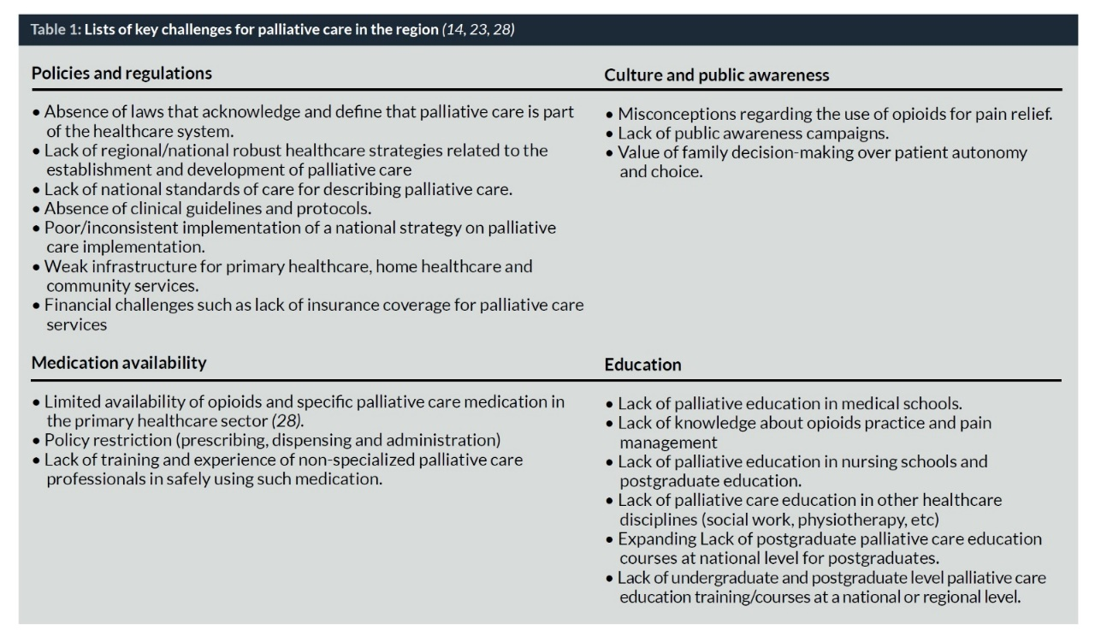

Slide 35
مدل ها و تجارب موفق جهانی در ادغام مراقبتهای تسکینی در نظام ارائه خدمات
The European Union has considered end-of-life and PC at the PHC level as a part of its current plans.
In addition, several countries including Canada, Spain, and recently Brazil, have implemented PC in PHC.
Integration of Palliative Care into the Primary Health Care of Iran ???

Slide 36
Thailand: palliative care integrated into
PHC
Thailand has a three-tiered public health care system: primary care units; district hospitals; and provincial hospitals.
The home care teams are supervised by palliative care units that now exist in 95% of the district hospitals. The palliative care units in district hospitals link with the palliative care units at the provincial hospital and with the CHCs .
This success was possible because of the existence of:
A strong PHC network;
A national programe for UHC; and
An effective training programe at a palliative care training canter.

Slide 37
Uganda: community-based palliative care with minimal integration into PHC .
Uganda was the first country in the world to enable specially trained and registered nurses to prescribe morphine .
Nongovernmental organizations (NGOs) play a major role in providing palliative care at the community level.
Basic palliative services now exist in 75% of the countries districts. However, these services often are provided by only one trained nurse at only one site in a district, which may be quite large .
Palliative care is not yet well integrated into the public health care system at all levels

Slide 38
Kerala, India: integration of palliative care into PHC using a public health approach
The state of Kerala in southern India has integrated palliative care into much of its well-developed PHC system.
In this state of 33 million people, an NGO in the city of Calicut created a palliative care service for the poor in the early 1990s
As of 2017, all the 1000 PHC centres in Kerala had a government nurse trained in palliative care who typically leads a home care programe staffed by local volunteers.

Slide 39
جمع بندی و ارائه مدل پیشنهادی برای سطوح مختلف نظام سلامت ایران
Organizing palliative care in Iran
Developing the family physician program / PHC approach /community base Initiatives /Health volunteer's

Slide 40
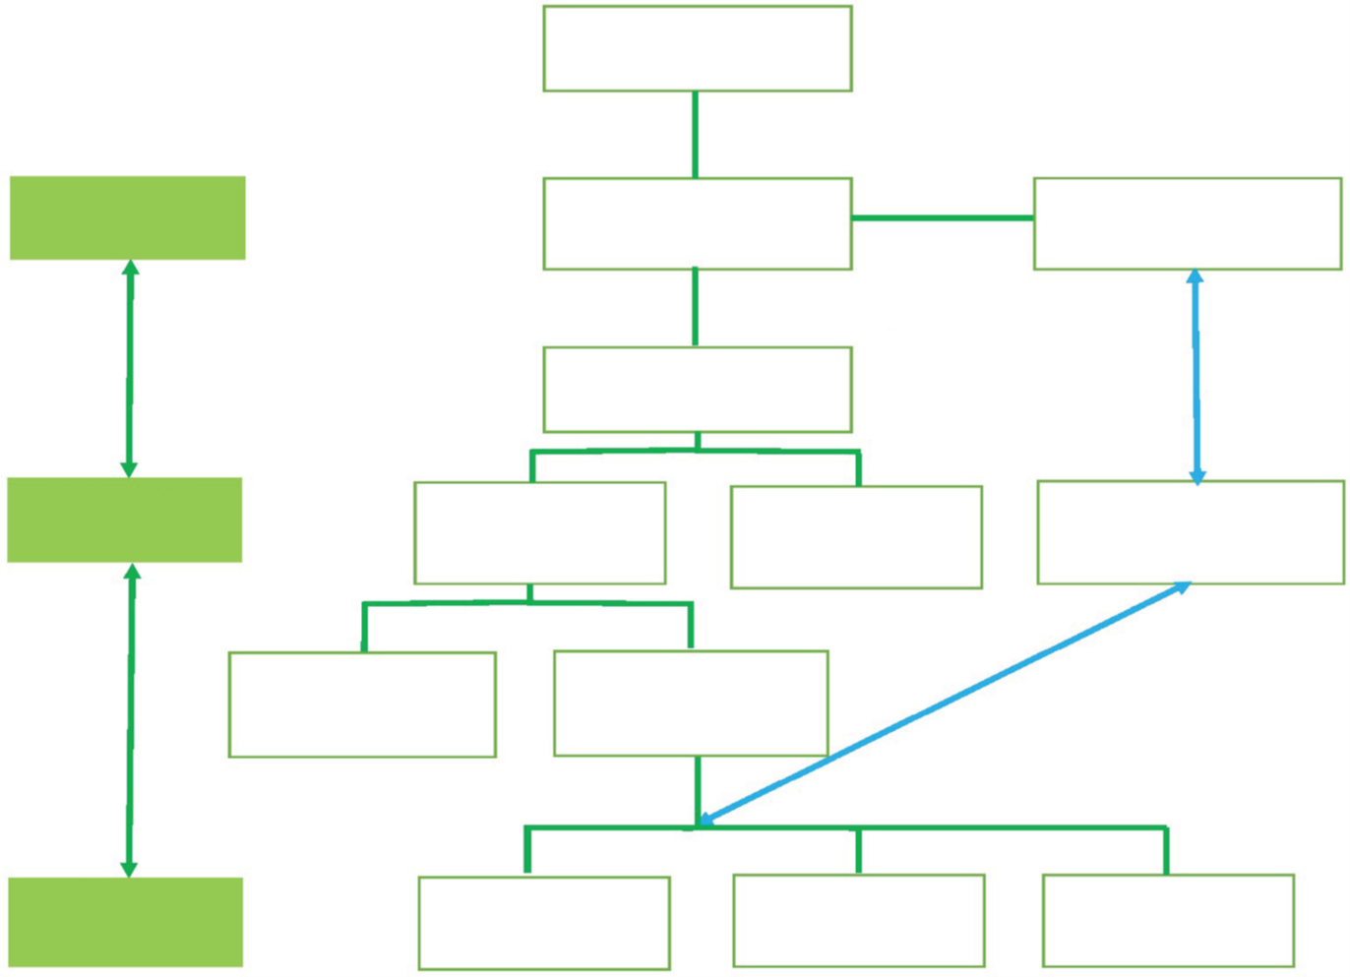
Integrated PC in Iran PHC

Slide 41
Conclusion
In regard to the growing elderly population in the country, a surge in NCDs and the increase in health care costs, the integration of PC into PHC is an undeniable necessity.
the concept of PC is required to be a point of consensus between the decision makers and providers of health care services. In addition, governmental organizations should create the necessary infrastructures for this integration, in co-operation with charity organizations, NGOs and volunteers through appropriate policy-making.

Slide 42
توصیه نهایی
PHC & essential package of palliative care should be include:
a set of safe, effective, inexpensive, off-patent and widely available medicines;
simple and inexpensive equipment;
basic social supports; and the human resources needed to provide the medicines, equipment and social supports effectively and safely
حرکت به سوی ادغام مراقبتهای تسکینی در نظام سلامت با مشارکت اجتماعی تمام و کمال

Slide 43
پرسش و پاسخ

Slide 44
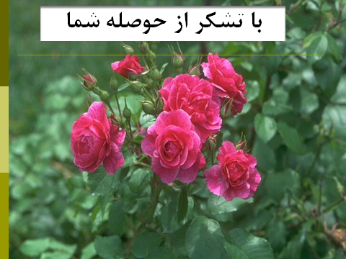
و من ا... التوفیق

